Slide 1


LUNG DISEASE & OXYGEN THERAPY
Course/Unit
Name of Student:
Date:

Slide 2

What’s Lung Disease?
A respiratory condition that affect the functioning of the lungs and provide certain limitations to an individual’s breathing system.
Diseases such as the chronic obstructive pulmonary disease (COPD) involves inflammation that leads to obstruction in the airflow from the lungs and it creates difficulties in the normal functioning (Newsome et al., 2018).

Slide 3
COPD Could be in the form of….
emphysema
chronic bronchitis.
这里输入简要文字说明这里输入简要文字说明这里输入简要文字说明这里输入简要文字说明
It is manifested in terms of inflammation and contraction in the size of the bronchial tubes and it is associated with a build-up of mucus that impair normal breathing (Biener et al., 2019).
It involves the destruction of the air sacs within the lungs and, therefore, an individual experiences difficulty in the outflow of the air (Story, 2020).

Slide 4
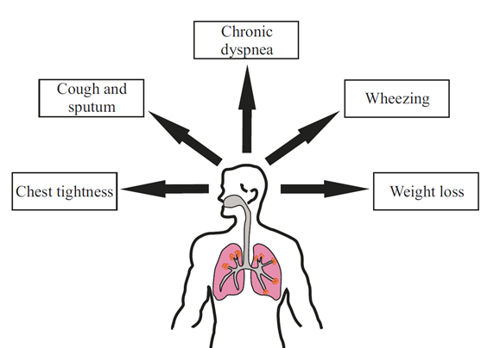
Symptoms of Lung Disease
1
Difficulty in breathing
2
Persistent Coughs
3
Shortness of breath
4
Need to clear throats
5
Wheezing sounds in breathing

Slide 5
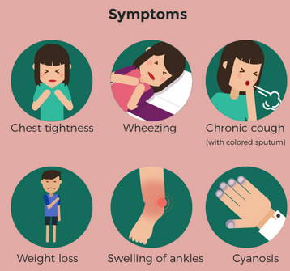
Symptoms (cont’d)
6
Swelling in legs & ankles
7
Fatigue & lack of energy
8
Confusion/feeling foggy
9
Tightness in the chest
10
Weight Loss
  Source: Story (2020)

Slide 6


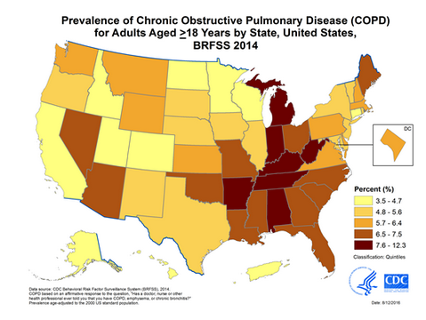


Annual Statistics on COPD
Affects up to 30 Million Americans
  Over 15.4 million visits to physicians
  Over 1.5 million visits to Emergency Departments
  726
  hospitalizations
  Source: May and Li, (2015)

Slide 7
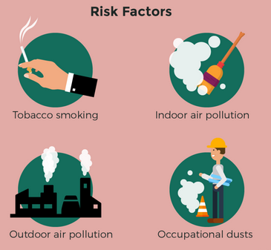
Causes of Lung Disease
Smoking of tobacco
Almost all of the patients with the chronic obstructive pulmonary disease (98.8 percent) were either current or former smokers (Lee et al., 2019).
Exposure to irritant Gases
Common among employees who worked in environments prone to toxic gases (Pietrangelo, 2021).
Genetic Causes
5 percent of COPD cases attributed to the deficiency of a protein known alpha-1-antitrypsin (Brode et al, 2012).

Slide 8
Prevention tips for Lung Disease
Avoiding/quitting smoking or exposure to second hand smoke
Limit exposure to pollutants such as irritant gases
Aerobic activity to boost heart functioning.
Adopting a healthy and well balanced diet

Slide 9
Prevention tips (cont’d)
General hygiene including washing hands
Taking a flu shot at least once a year
Regular check-ups with a physician

Slide 10
Treatment Options
  Taking of bronchodilators which help relax and widen a person’s airways to support better threating (Pietrangelo, 2021).
  The use of oral steroids also helps in elevating the breathing functions.
  Besides, corticosteroids also ease the swellings and antibiotics help fight the bacterial and viral infections that may worse the condition (Pietrangelo, 2021).
  In addition to that, rescue inhalers also come in handy especially in emergencies.
  Then, there is the use of oxygen therapy (Pichardo, 2021) (see next slides)
  Lung Disease has NO Cure
There are approaches to manage symptoms and delay progression of the disease

Slide 11
Oxygen
Therapy
The use of oxygen concentrators such as the Zen-O portable oxygen concentrators (POCs) is an ideal way to administer oxygen to persons with respiratory symptoms of lung disease (Pichardo, 2021).

Slide 12
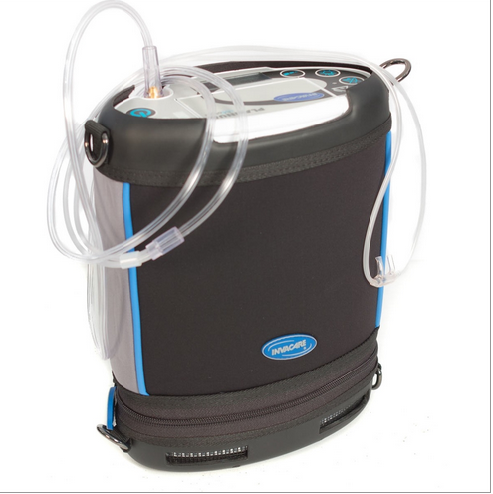
The POCs
Lightweight
Mobile
8
Rechargeable
9
No refilling needed
  Source: Pichardo (2021)

Slide 13
ATS Guidelines
  There are specific guidelines in the use of home oxygen therapy as recently outlined by the American Thoracic Society (ATS) in November 2020.
  These guidelines explore the latest clinical evidence on indications, prescription and use of oxygen home therapy among individual with lung diseases (Jacobs et al., 2020).
  Recommendations include:
- Moderate to Low Quality Evidence:
    - Prescribe long-term oxygen therapy (LTOT) for at least 15 h/d for adults with COPD who have severe chronic resting room air hypoxemia.
    - Do not prescribe LTOT for adults with COPD who have moderate chronic resting room air hypoxemia.
    - Prescribe ambulatory oxygen for adults with COPD who have severe exertional room air hypoxemia.
- Low to Very Low Quality Evidence:
- Prescribe LTOT for at least 15 h/d for adults with ILD who have severe chronic resting room air hypoxemia.
- Prescribe ambulatory oxygen for adults with ILD who have severe exertional room air hypoxemia.
- Prescribe portable liquid oxygen (LOX) for patients with chronic lung disease who are also mobile outside of the home and would require continuous oxygen flow rates of >3 L/min during exertion.
  These recommendations on prescribing and using home oxygen should be adhered to for better health outcomes (Jacobs et al., 2020).

Slide 14
References
Biener, A., Decker, S., Rohde, F. (2019). Prevalence and Treatment of Chronic Obstructive Pulmonary Disease (COPD) in the United States. JAMA, 322(7), 602-613. Doi:10.1001/jama.2019.10241
Brode, S. K., Ling, S. C., & Chapman, K. R. (2012). Alpha-1 antitrypsin deficiency: a commonly overlooked cause of lung disease. CMAJ: Canadian Medical Association journal, 184(12), 1365–1371. Doi: 10.1503/cmaj.111749
Jacobs, S., Krishnan, J., Lederer, D., Ghazipura, M., Hossain, T., Tan, A., Carlin, B., Drummond, M., Ekström, M., Garvey, C., Graney, B. (2020). Home Oxygen Therapy for Adults with Chronic Lung Disease. An Official American Thoracic Society Clinical Practice Guideline. American Journal of Respiratory and Critical Care Medicine, 202(10):e121-41.
Lee, J., Jung, H.M., Kim, S.K. et al. (2019).Factors associated with chronic obstructive pulmonary disease exacerbation, based on big data analysis. Sci Rep, 9, 6679-6687. Doi: 10.1038/s41598-019-43167-w
May, S. M., & Li, J. T. (2015). Burden of chronic obstructive pulmonary disease: healthcare costs and beyond. Allergy and asthma proceedings, 36(1), 4–10. Doi: 10.2500/aap.2015.36.3812
Newsome, B., McDonnell, K., Hucks, J., Estrada, R. (2018). Chronic Obstructive Pulmonary Disease. Clin J Oncol Nurs, 22(2): 184–192. Doi: 10.1188/18.CJON.184-192
Pichardo, G. (2021). COPD and Portable Oxygen Therapy. WebMD. Retrieved on 16 April 2021 from https://www.webmd.com/lung/copd/copd-portable-oxygen-therapy
Pietrangelo, A. (2021). Everything You Need to Know About Chronic Obstructive Pulmonary Disease (COPD). Health Line. Retrieved on 16 April 2021 from https://www.healthline.com/health/copd
Story, C. (2018). Chronic Lung Diseases: Causes and Risk Factors. Health Line. Retrieved on 16 April 2021 from https://www.healthline.com/health/understanding-idiopathic-pulmonary-fibrosis/chronic-lung-diseases-causes-and-risk-factors#Lung-cancer

